Slide 1
CENTEK GROUP
An introduction

Slide 2
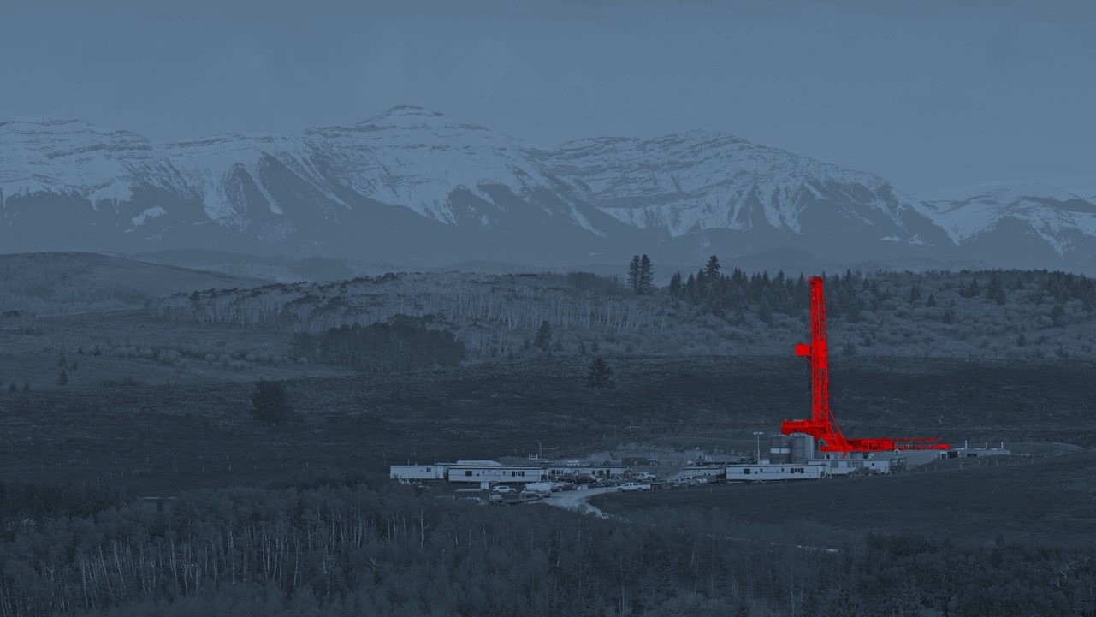

Centek Mission:
TO ENABLE SAFER AND MORE PRODUCTIVE ACCESS TO ENERGY
ONE WELL AT A TIME

Slide 3
Reasons to choose Centek
Whatever the casing running challenge, Centek has the product to meet it
Benchmark for centralization products for nearly 25 years
Proven performance against key competitors
Innovator of new technology for challenging wells
R&D excellence
Unrivalled quality standards

Slide 4
Centek key milestones
US facility opens
UROS launched
Company registered
Launch of the Slider II
Global coverage
Further expansion
New products launched
Supplying products to North America and GoM
Innovative, award winning product for under-reamed wells available
Centek Ltd registered in the UK
Centek S2 used in the North Sea
Centek operating in 25 countries
Sales force operating on all continents
Full string portfolio
2001
2002
2008
2010
2012
2015
2017
2024
2023
2021
2020
2019
2018
Product development
Innovation UK funding secured
Centek is 20 years old!
Competitive testing
Launched S2-H
Centek joins Madison Group
Low friction product development
Low friction material research project commences
New Customer Portal available
Centek prove their products perform better than key competitors
Ground-breaking new hinged centralizer is as strong as S2
Centek becomes part of the Energy vertical

Slide 5
Short leadtimes from 3 strategic locations

Slide 6


















The full line-up of centralizers
WELL TYPE | ONSHORE |  |  |  |  | ONSHORE + OFFSHORE |  |  | UNDER-REAM / OFFSHORE
WELL LEVEL |  |  |  | L2 | L2 + L3 | (L1+L2)+L3 |  |  | (L3+L4)
PRODUCT NAME | OSN | OBH | OBH-W | OBS-2 | OBS | S2-HD | S2 | S2 Hinged | TUR (includes variants) | UROS (includes variants)
 | Solid body with straight or spiral vanes | Non-welded bow spring with hinge | Welded bow spring with hinge | Single piece, bow spring | Single piece, bow spring | Heavy duty single piece, bow spring | Single piece, bow spring | Hinged bow spring | Single piece, bow spring | Single piece, bow spring
FLEXIBILITY (0-8)
RUNABILITY (0-8)
STRENGTH (0-8)

Slide 7
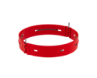









The full line-up of stop collars
WELL TYPE | ONSHORE |  | ONSHORE + OFFSHORE
WELL LEVEL | L1 | L2 | (L1+L2)+L3+L4
PRODUCT NAME | HSN | 0SO | 00SO | 00SH | HDSO | HDSH
 | Hinged stop collar with spiral nail fitment | Slip on stop collar with set screws | Slip on stop collar with set screws | Hinged, stop collar with set screws | Heavy duty, slip on stop collar with set screws | Hinged, heavy duty stop collar with set screws
RUNABILITY (0-8)
STRENGTH (0-8)

Slide 8




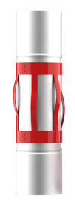
Application Guide
L1
L2
L3
Wherever you want to go, we’ll get you there…
L4

Slide 9




Level 1&2 Product Strategy
NORTH AND SOUTH AMERICA
EUROPE, MIDDLE EAST AND AFRICA (EMEA)
ASIA PACIFIC (APAC)
OBH-W
OSN
OBS-2
OBS
OSN
OBH
OBS-2
OBS
OBH
OBH-W
OSN
OBS-2
OBS

Slide 10
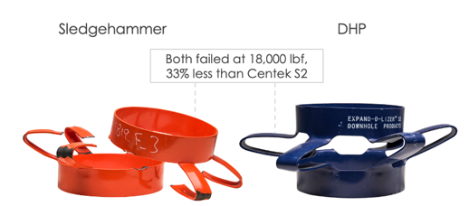
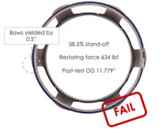
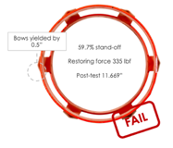
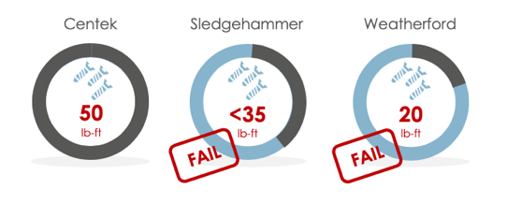
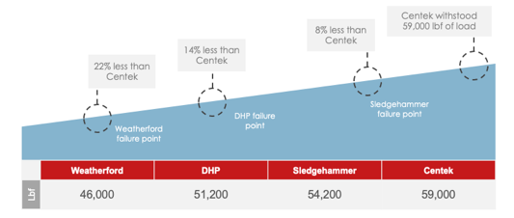
Competitor testing overview
API 10D 6th Edition Restoring Force Test
Axial Compression Test
DHP
Sledgehammer
58.5% stand off
59.7% stand off
Over-torque Stop Collar Installation test
Stop Collar Burst Test

Slide 11
Superior performance
Centralizer
Stop Collar
higher restoring force
Centek grub screws reached
90%
30
lb-ft higher torque
Installation
Restoring Force
Compared to Sledgehammer 9 5/8 x 12 1/4” centralizers
Burst
Compared to Weatherford 7” stop collars*
Axial Compression
TEST
33% stronger
22% stronger
Compared to DHP 9 5/8 x 12 1/4” centralizers
Compared to Weatherford 7” stop collars
Centralizer
Stop Collar

Slide 12
Don’t take our word for it
The main benefit of the Centek S2s has been their performance downhole, helping casing to run to TD compared to wells with other centralizers where the casing got stuck or ran 100m - 200m short of TD, resulting in yields being substantially reduced, compared to plan.
Gary Zhang, General Manager, Vertechs Oil & Gas Co. Ltd
No issue at all to get casing to the bottom. We managed to rotate while cementing approximately 20rpm, 10-15kft lbs torque. Will be using the same for the next 2 wells.
Mohd Irfan, Talisman Energy
Great bit of work to get the liner in the hole and rotating
Operator
It was a good decision to use the Centeks! Due to the special development costs and special testing, we had to invest more money, but the job went well and the investment was worth it.
Operator
It was like having ball bearings in the hole!
Operator
While on bottom in a 12,000ft well we were able to rotate at 60rpm and the bond log results were excellent.
Drilling Engineer

Slide 13
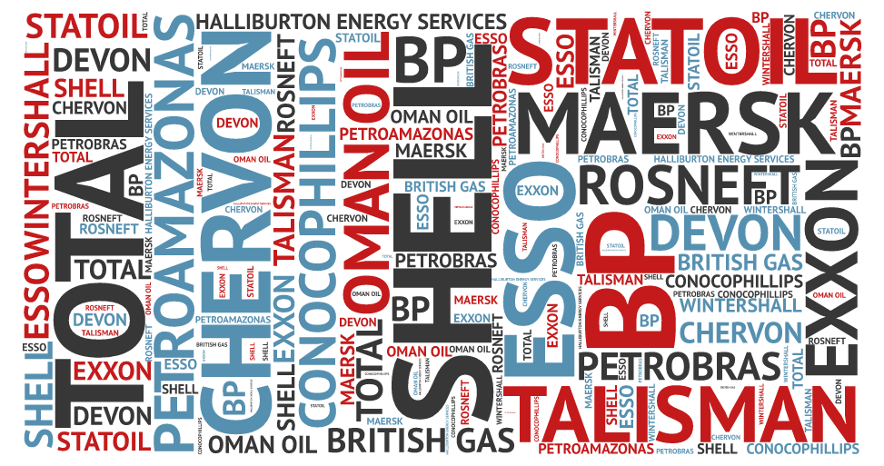
Global operators*
*Just a small selection

Slide 14
Global footprint
US – Oklahoma City
68,100ft² factory and warehouse space
9,000ft² office space
1,173,333 piece capacity
UK – Newton Abbot (Head Office)
83,000ft² factory and warehouse space
17,000ft² office space
1,925,000 piece capacity
PRC – Weinan City
213,771ft² factory and warehouse space
118,403ft² office space
120,000 piece capacity
Key
Manufacturing facility

Slide 15
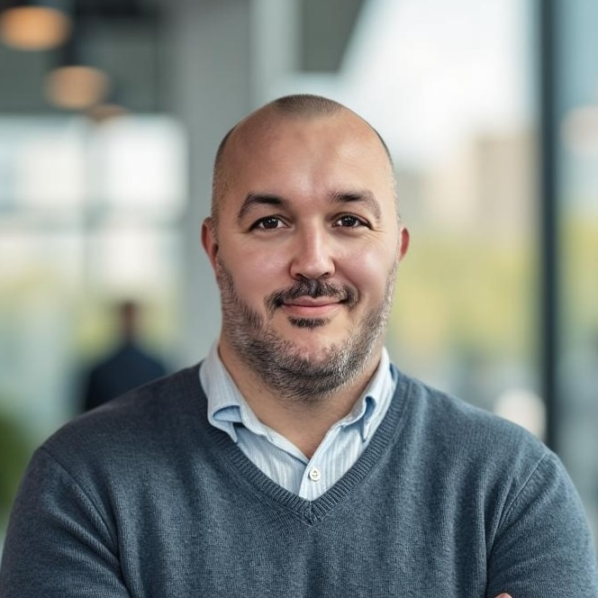
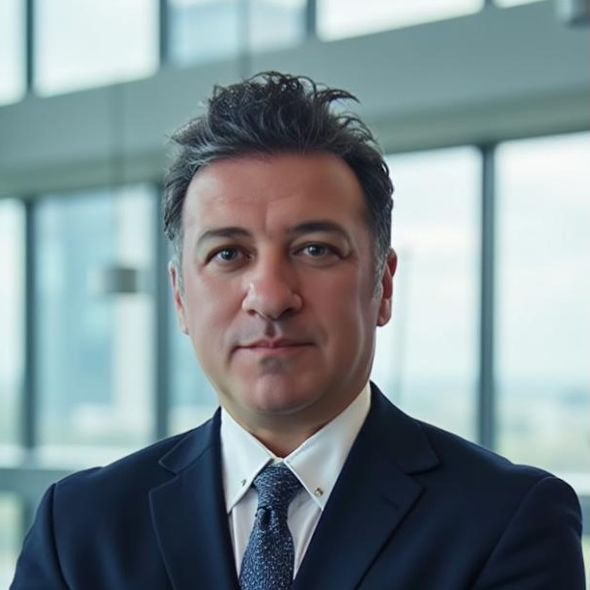
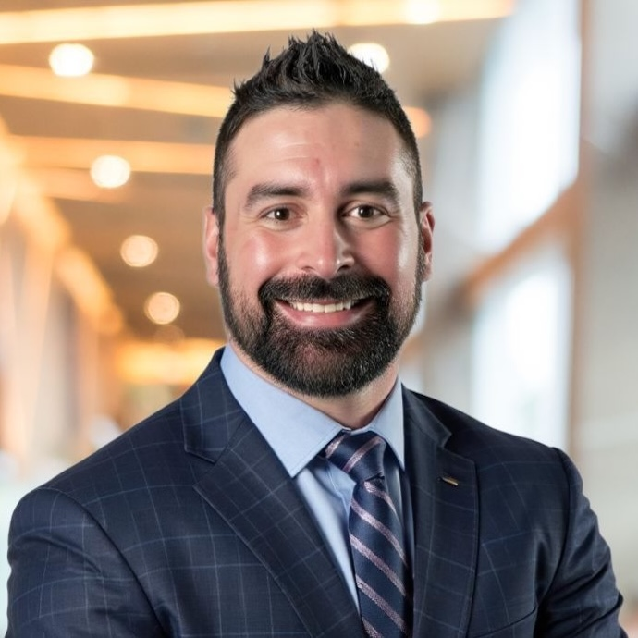
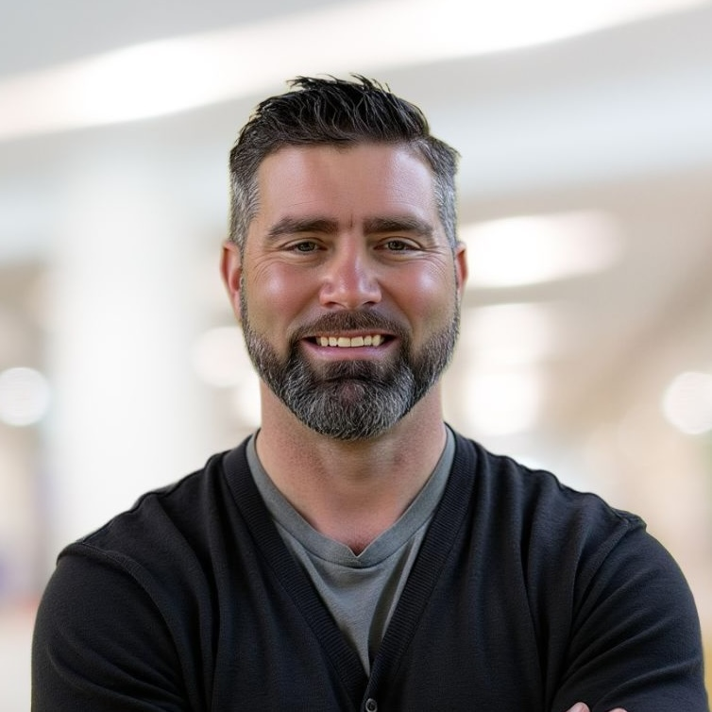
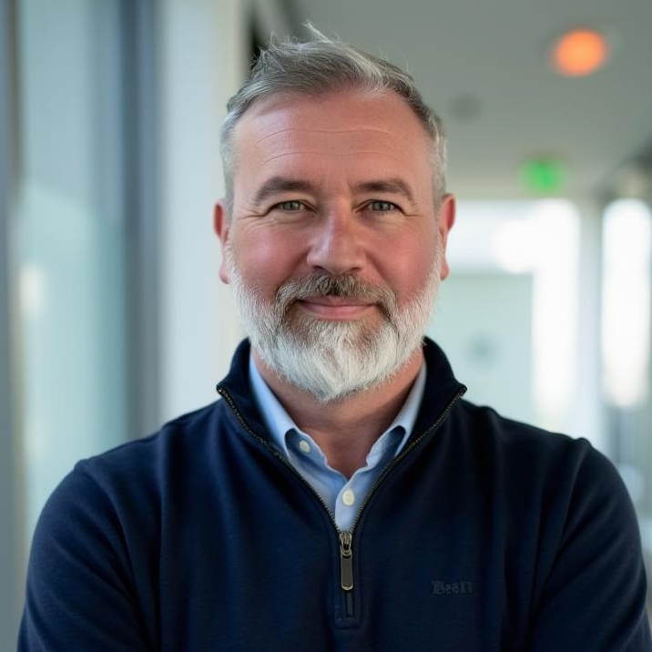
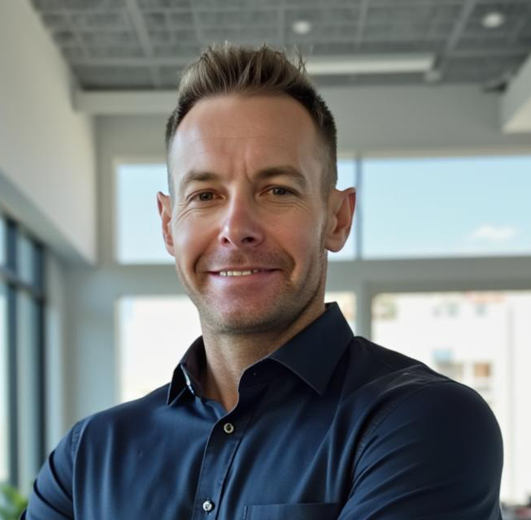
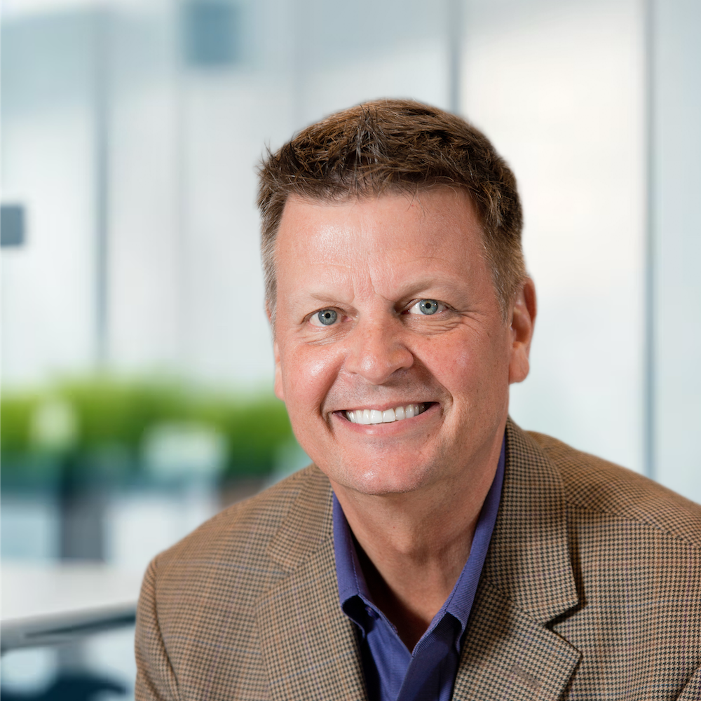
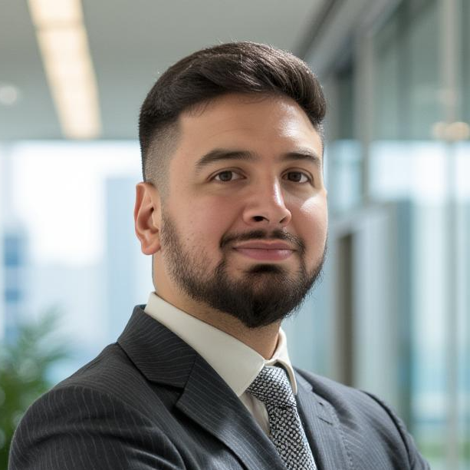
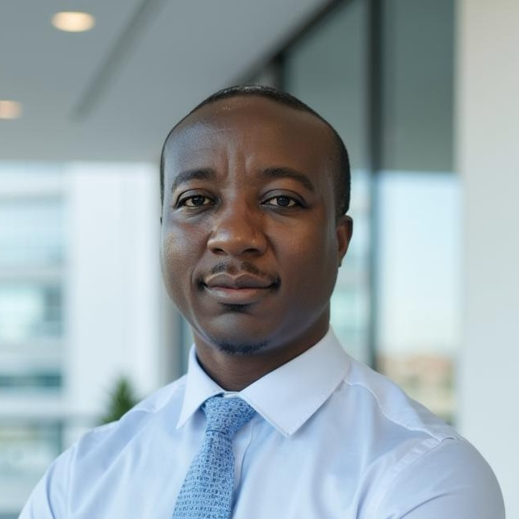

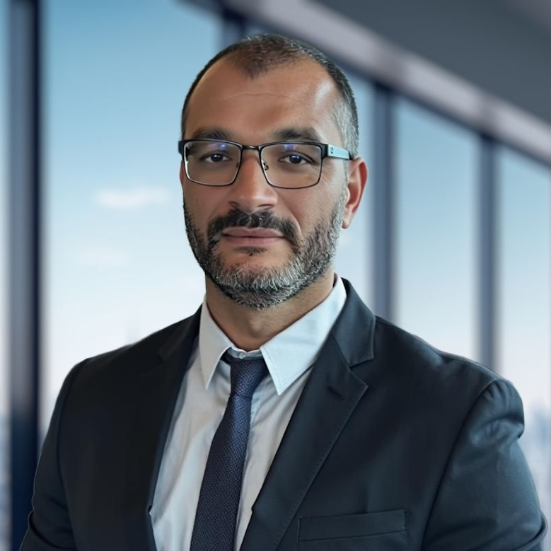

Our customer support team
SHAUN MOUNTAIN
UK & Norway
MAHDI Daryoush
Europe and Caspian Sea
SAM LOPEZ
Northeast USA
CHASE DAVIS
North American Sales Manager
STUART FORRESTER
Dubai, Kuwait, Oman, India & Pakistan
CHRIS LEE
Permian
RANDY STARNES
South Texas
ANDRES GONZALEZ
Caribbean
MARCEL NAMATA
Sub Saharan Africa
LORENA HERNANDEZ
Latin America & Mexico
GUSTAVO WILDEMBERG
Brazil
RUGAYA SALIM
Asia Pacific & ANZ

Slide 16
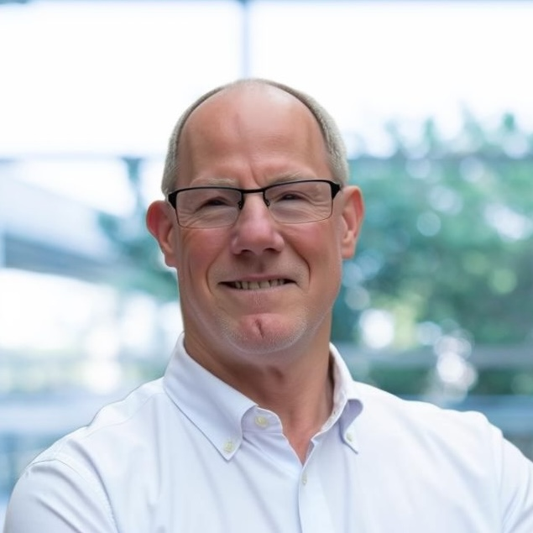
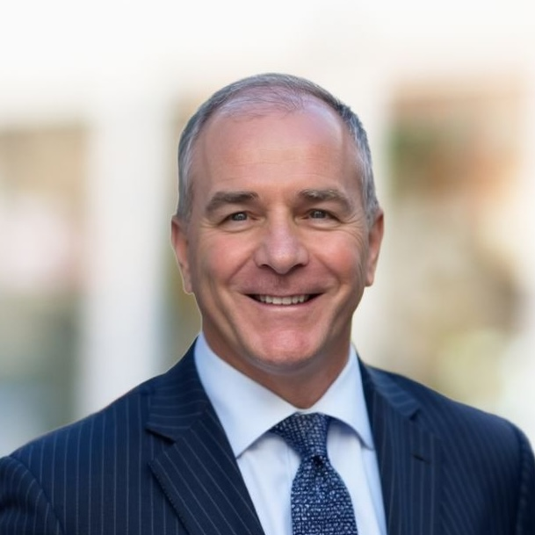
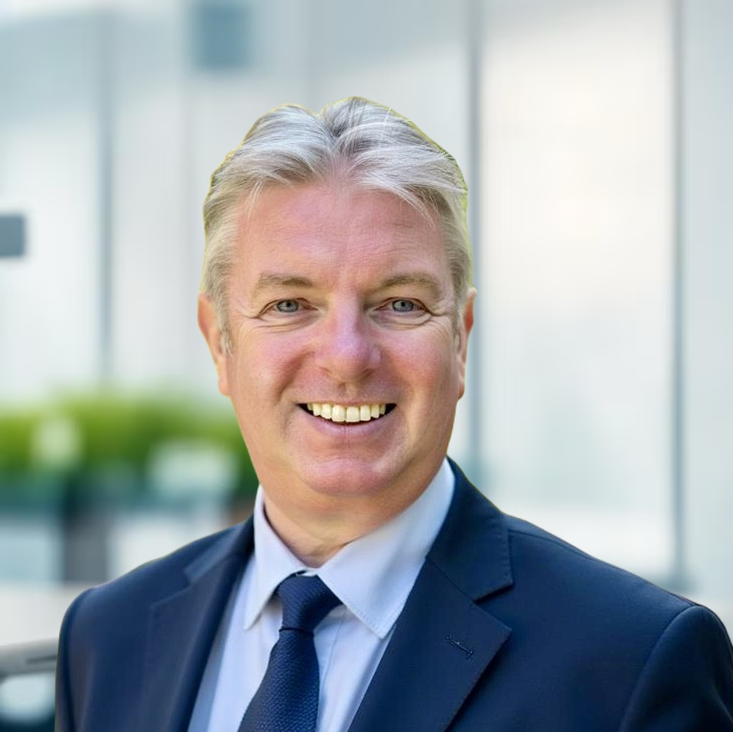
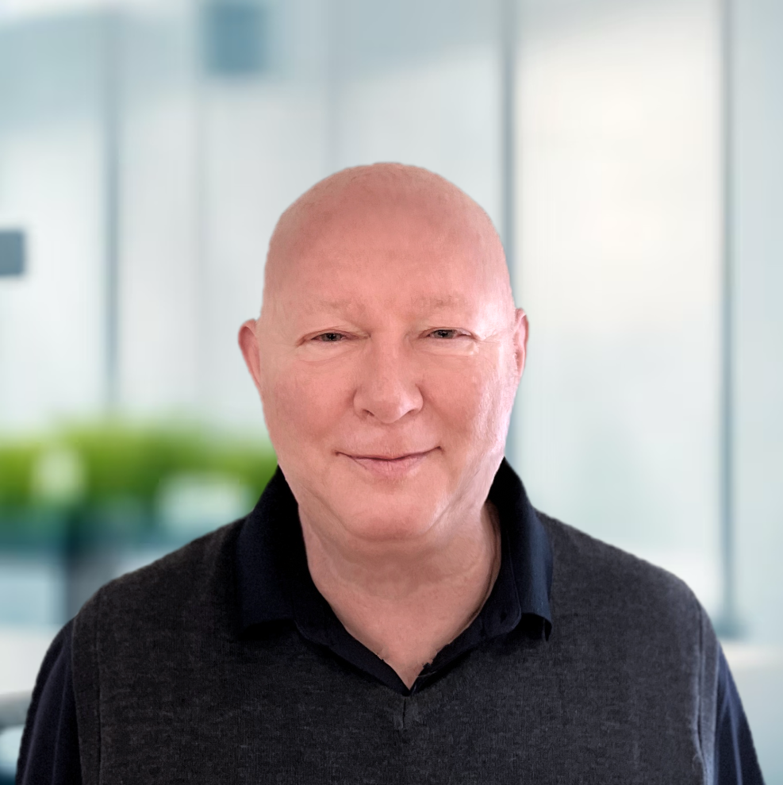
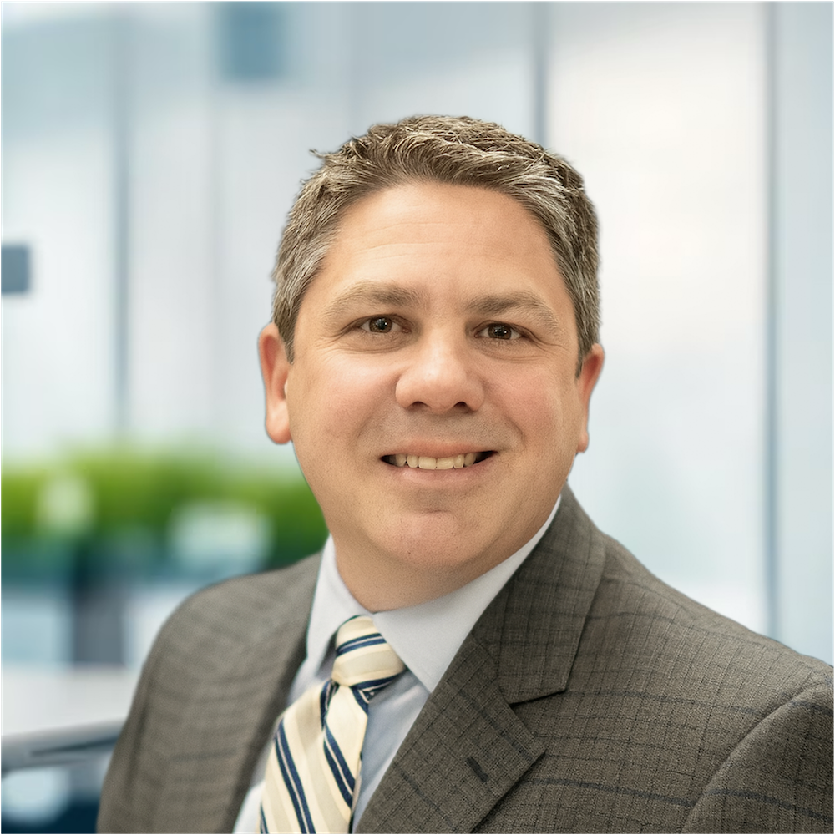
Your senior team
TOM CRONE
President & CEO
JOHN COSTINE
Global Director, Marketing and Product Management
ANDREW ROSS
Managing Director VP Centek Limited
PETER HINTON
Vice President, Eastern Hemisphere Operations and General Manager
BARRY COATS
General Manager of Centek Inc.
& Chief Financial Officer

Slide 17
Our competitive advantage
1
Local, high quality manufacturing - trusted partner
2
Optimized performance
3
Support – simulations, marketing, sales tools, brand pull
4
Testing protocols to ensure performance is guaranteed to match datasheet
5
Full string provision – from top to bottom
6
Higher margins

Slide 18



Centek unique offer
Single source for
80%
of centralizer market
RIGHT PRODUCT
FOR THE RIGHT PRICE
Closing the performance gap
Higher margins. Full range at competitive price point
IN THE RIGHT PLACE
Quality manufacturing in multiple locations.
Global supply

Slide 19
Any questions…
?

Slide 20
Disclaimer
This presentation is provided on a strictly private and confidential basis for information purposes only.
By attending or reading this presentation, you will be deemed to have agreed to the obligations and restrictions set out below:
Without the express prior written consent of the Centek Group, this presentation and any information contained within it may not be
reproduced (in whole or in part),
copied at any time,
printed,
used for any purpose other than your evaluation of Centek Group or
provided to any other person, except your employees and advisors who are advised of the confidentiality of the information.

