Slide 1
Eco-Standard Presentation

Slide 2
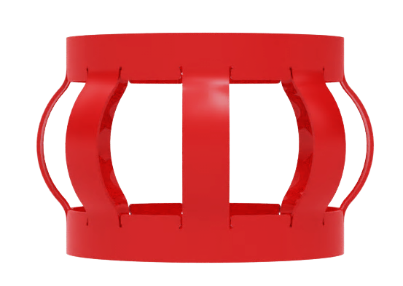
Competitive Centralizer Solutions
Introducing the Eco-Standard centralizer—our latest economical, single-piece solution engineered for most applications.
Reducing time and costs to TD
  Integrated tabs into the end-band to increase flexibility, significantly enhancing run-in-hole (RIH) efficiency
High durability in casing running environments
  Core design from the Centek S2 with seamless construction, zero weak points and jigsaw joint, offering high durability in casing running environments.
Reduced the contact with the casing or wellbore walls.
  The unit is heat treated and has a double curvature on each bow to reduce the contact with the casing or wellbore walls.
Guaranteed performance.
  The range is tested to exceed the API10D 7th edition standard.

Slide 3
Eco-Standard Centralizer Features
Tested to API 10D 7th Edition
Double curvature bow
Jigsaw joint
Zero weak points
Heat treated
Low profile unit, providing high flow-by-area
High standoff ratio
Robust yet flexible
Fully traceable, unique quality control
Original unique design

Slide 4
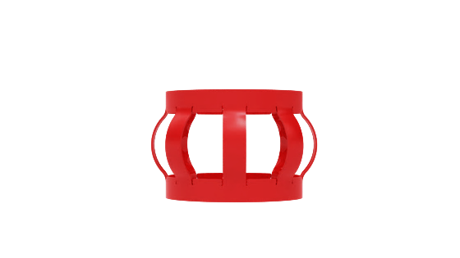






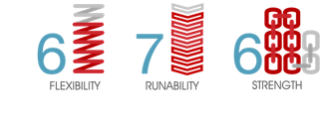
ES Centralizer
Unique Design
Lower cost alternative to S2
High Flexibility
High restoring forces
Exceeds API 10D version 7
Low start and running forces
Bow spring
single piece centralizer
Shorter compared to the premium Centek S2 but maintains a high restoring force to meet the needs of most well designs
Designed with integrated tabs into the end-band to increase flexibility.

Slide 5

















The Range
WELL TYPE | ONSHORE |  |  | ONSHORE + OFFSHORE |  |  |  | UNDER-REAM / OFFSHORE
WELL LEVEL | L1 |  |  | L2 | (L1+L2)+L3 |  |  | (L3+L4)
PRODUCT NAME | OSN | OBH | OBH-W | ES | S2-HD | S2 | S2 Hinged | TUR (includes variants) | UROS (includes variants)
 | Solid body spiral vanes | Non-welded bow spring with hinge | Welded bow spring with hinge | Single piece, bow spring | Heavy duty single piece, bow spring | Single piece, bow spring | Hinged bow spring | Single piece, bow spring | Single piece, bow spring
FLEXIBILITY (0-8)
RUNABILITY (0-8)
STRENGTH (0-8)

Slide 6

The Range
WELL TYPE | ONSHORE + OFFSHORE |  |  |  | UNDER-REAM / OFFSHORE
WELL LEVEL | L2 | (L1+L2)+L3 |  |  | (L3+L4)
PRODUCT NAME | ES | S2-HD | S2 | S2 Hinged | TUR (includes variants) | UROS (includes variants)
 | Single piece, bow spring | Heavy duty single piece, bow spring | Single piece, bow spring | Hinged bow spring | Single piece, bow spring | Single piece, bow spring
FLEXIBILITY (0-8)
RUNABILITY (0-8)
STRENGTH (0-8)

Slide 7
Product Sizes
Product size | Centralizer Part Number | Recommended Stop Collar Part Number
4-1/2" ID for use in 6" Hole | 0412-0600ES | 0412-OSO
5" ID for use in 6" Hole | 0500-0600ES | 0500-OSO
5" ID for use in 6-1/2" Hole | 0500-0612ES | 0500-OSO
5" ID for use in 6-1/8" Hole | 0500-0618ES | 0500-OSO
5" ID for use in 6-3/4" Hole | 0500-0634ES | 0500-OSO
5-1/2" ID for use in 8-1/2" Hole | 0512-0812ES | 0512-OSO
5-1/2" ID for use in 8-3/4" Hole | 0512-0834ES | 0512-OSO
7" ID for use in 8-1/2" Hole | 0700-0812ES | 0700-OSO
7" ID for use in 8-3/4" Hole | 0700-0834ES | 0700-OSO
7-5/8" ID for use in 8-1/2" Hole | 0758-0812ES | 0758-OSO
7-5/8" ID for use in 8-3/4" Hole | 0758-0834ES | 0758-OSO
9-5/8" ID for use in 12-1/4" Hole | 0958-1214ES | 0958-OSO
13-3/8" ID for use in 16" Hole | 1338-1600ES | 1338-OSO
13-3/8" ID for use in 17-12" Hole | 1338-1712ES | 1338-OSO
14” ID for use in 17-1/2” Hole | 1400-1712ES | 1400-OSO

